Slide 1

AF1001 Fundamentals of Accounting (BSE-3rd Semester)
Mr. Sami Ullah
Lecturer NU Fast Peshawar

Slide 2
The sequence of accounting procedures used to record, classify, and summarize accounting information in financial reports at regular intervals is often termed the accounting cycle.
The accounting cycle begins with the initial recording of business transactions and concludes with the preparation of a complete set of formal financial statements.
The term cycle indicates that these procedures must be repeated continuously to enable the business to prepare new, up-to-date financial statements at reasonable intervals.

Slide 3
Steps in Accounting Cycle:
The accounting cycle generally consists of eight specific steps. In this chapter, we illustrate how businesses (1) journalize (record) transactions, (2) post each journal entry to the appropriate ledger accounts, and (3) prepare a trial balance.
The remaining steps of the cycle will be addressed in Chapters 4 and 5. They include (4) making end-of-period adjustments, (5) preparing an adjusted trial balance, (6) preparing financial statements, (7) journalizing and posting closing entries, and (8) preparing an after-closing trial balance (Post-closing Trial balance).

Slide 4
THE ROLE OF ACCOUNTING RECORDS
The cyclical process of collecting financial information and maintaining accounting records does far more than facilitate the preparation of financial statements. Managers and employees of a business frequently use the information stored in the accounting records for such purposes as:
1. Establishing accountability for the assets and/or transactions under an individual’s control.
2. Keeping track of routine business activities—such as the amounts of money in company bank accounts, amounts due from credit customers, or amounts owed to suppliers.
3. Obtaining detailed information about a particular transaction.
4. Evaluating the efficiency and performance of various departments within the organization.
5. Maintaining documentary evidence of the company’s business activities. (For example, tax laws require companies to maintain accounting records supporting the amounts reported in tax returns.)

Slide 5
In an actual accounting system, the information about each business transaction is initially recorded in an accounting record called the journal. This information is later transferred to the appropriate accounts in the general ledger.
The journal is a chronological (day-by-day) record of business transactions. At convenient intervals, the debit and credit amounts recorded in the journal are transferred (posted) to the accounts in the ledger. The updated ledger accounts, in turn, serve as the basis for preparing the company’s financial statements.

Slide 6
To illustrate the most basic type of journal, called a general journal, let us examine the very first business transaction of Overnight Auto Service.
On January 20, 2011, the McBryan family invested $80,000 in exchange for capital stock. Thus, the asset Cash increased by $80,000, and the owners’ equity account Capital Stock increased by the same amount.
Applying the debit and credit rules discussed previously, we know that increases in assets are recorded by debits, whereas increases in owners’ equity are recorded by credits. As such, this event requires a debit to Cash and a credit to Capital Stock in the amount of $80,000. The transaction is recorded in the company’s general journal as illustrated in Exhibit 3–1 .

Slide 7
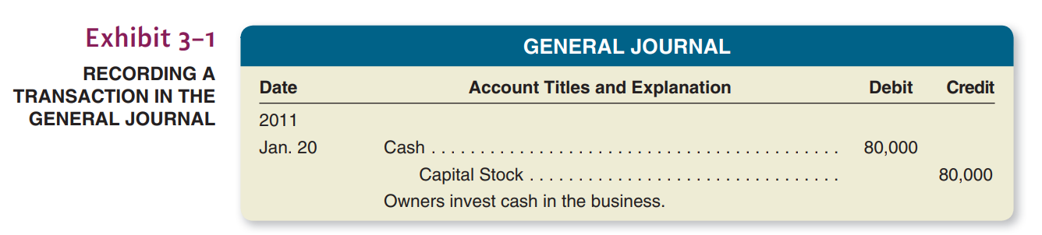
Note the basic characteristics of this general journal entry:
The name of the account debited (Cash) is written first, and the dollar amount to be debited appears in the left-hand money column.
The name of the account credited (Capital Stock) appears below the account debited and is indented to the right. The dollar amount appears in the right-hand money column.
A brief description of the transaction appears immediately below the journal entry.

Slide 8
A familiarity with the general journal form of describing transactions is just as essential to the study of accounting as a familiarity with plus and minus signs is to the study of mathematics. The journal entry is a tool for analyzing and describing the impact of various transactions on a business entity. The ability to describe a transaction in journal entry form requires an understanding of the nature of the transaction and its effect on the financial position of the business.

Slide 9
Step 2: POSTING JOURNAL ENTRIES TO THE LEDGER ACCOUNTS (AND HOW TO “READ” A JOURNAL ENTRY)
We have made the point that transactions are recorded first in the journal. Ledger accounts are updated later, through a process called posting. (In a computerized system, postings often occur instantaneously, rather than later.)
Posting simply means updating the ledger accounts for the effects of the transactions recorded in the journal. Viewed as a mechanical task, posting basically amounts to performing the steps you describe when you “read” a journal entry aloud.

Slide 10
Consider the first entry appearing in Overnight’s general journal. If you were to read this entry aloud, you would say: “Debit Cash, $80,000; credit Capital Stock, $80,000.” That’s precisely what a person posting this entry should do: Debit the Cash account for $80,000, and credit the Capital Stock account for $80,000.
Consider the first entry appearing in Overnight’s general journal. If you were to read this entry aloud, you would say: “Debit Cash, $80,000; credit Capital Stock, $80,000.” That’s precisely what a person posting this entry should do: Debit the Cash account for $80,000, and credit the Capital Stock account for $80,000.
The posting of Overnight’s first journal entry is illustrated in Exhibit 3–2 . Notice that no new information is recorded during the posting process. Posting involves copying into the ledger accounts information that already has been recorded in the journal.

Slide 11
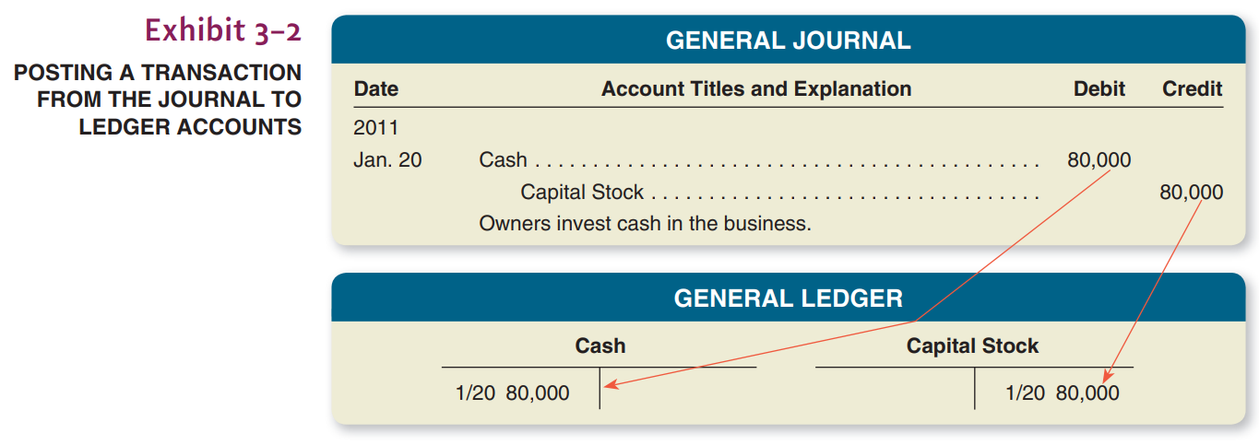

Slide 12

Each transaction from January 20 through January 27 is analyzed first in terms of increases in assets, liabilities, and owners’ equity. Second, we follow the debit and credit rules for entering these increases and decreases in specific accounts. Asset ledger accounts are shown on the left side of the analysis; liability and owners’ equity ledger accounts are shown on the right side.

Slide 13
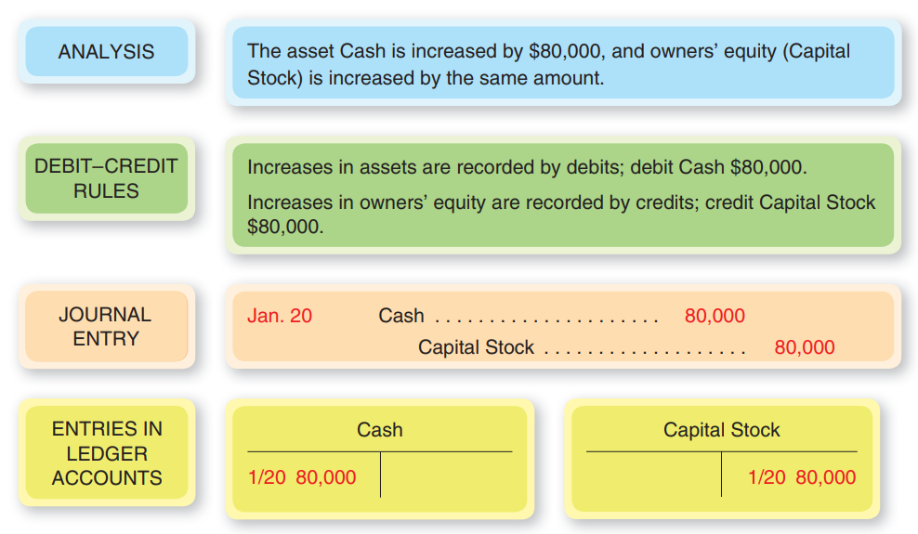

Slide 14
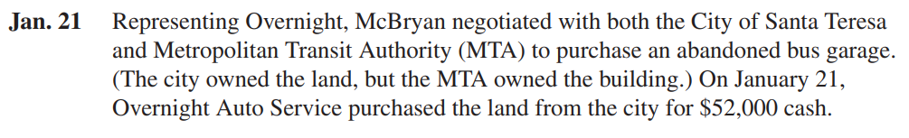
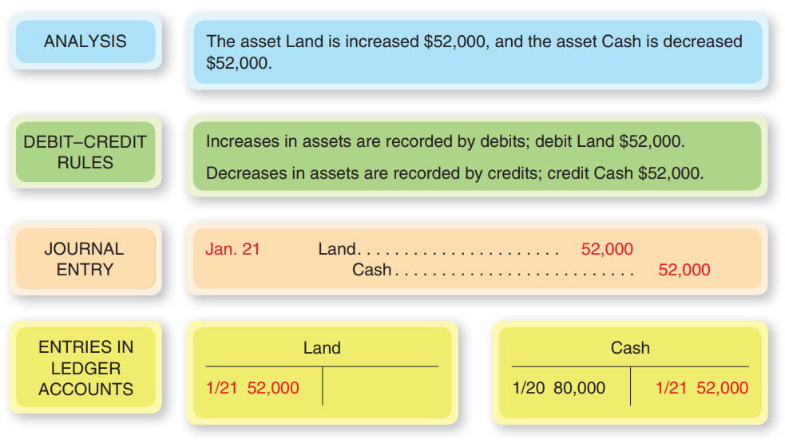

Slide 15
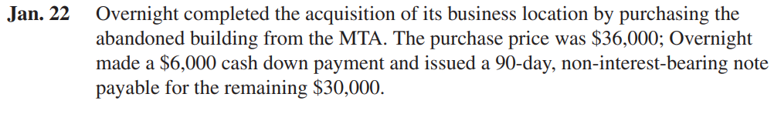
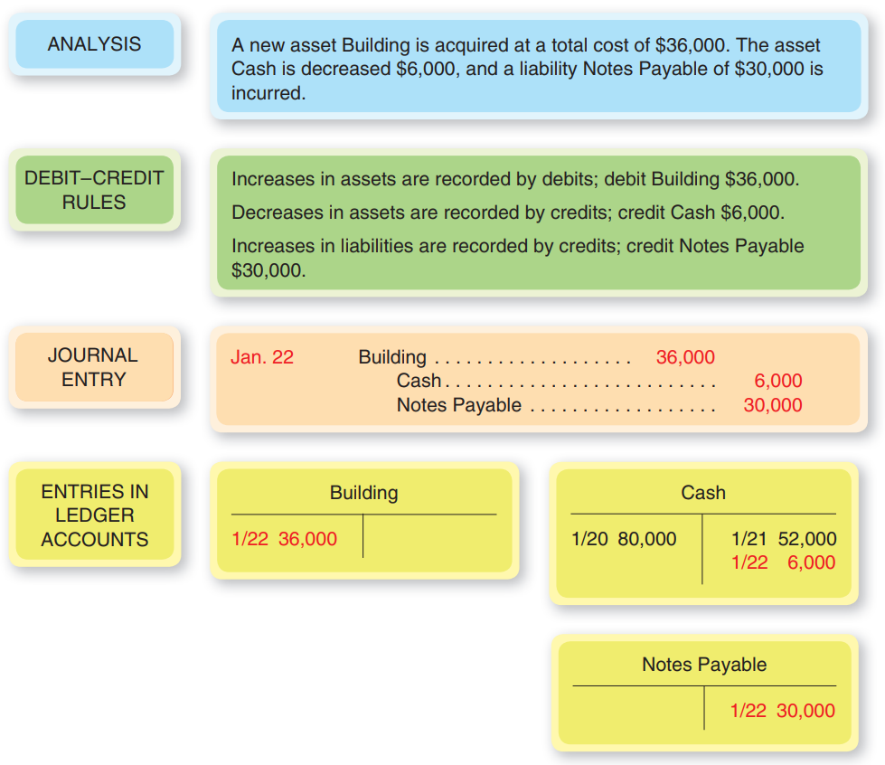

Slide 16
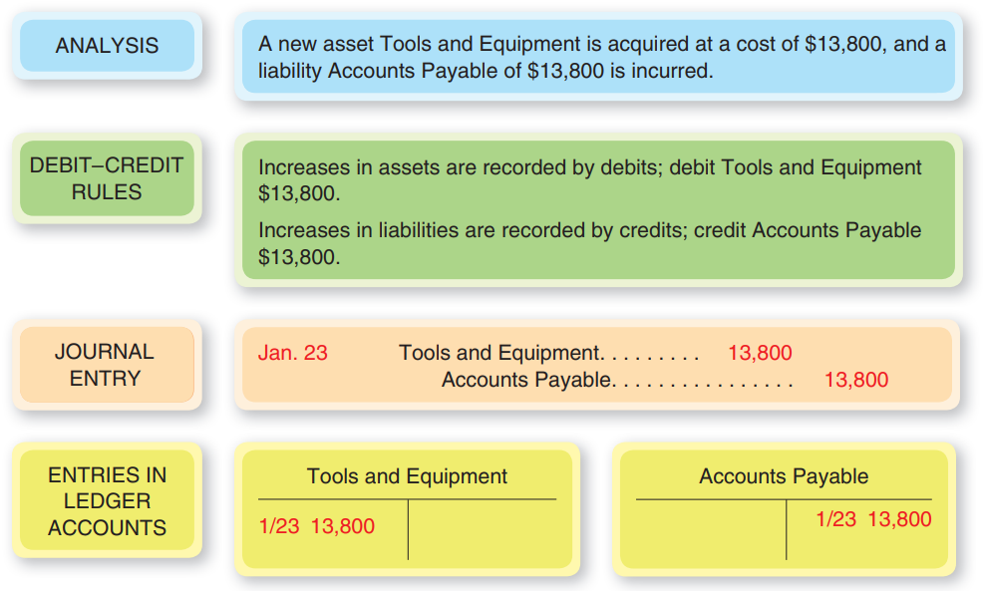

Slide 17
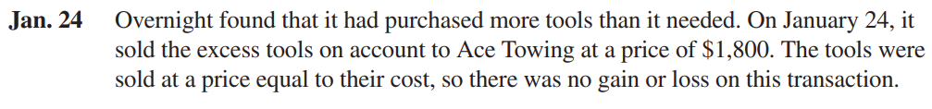
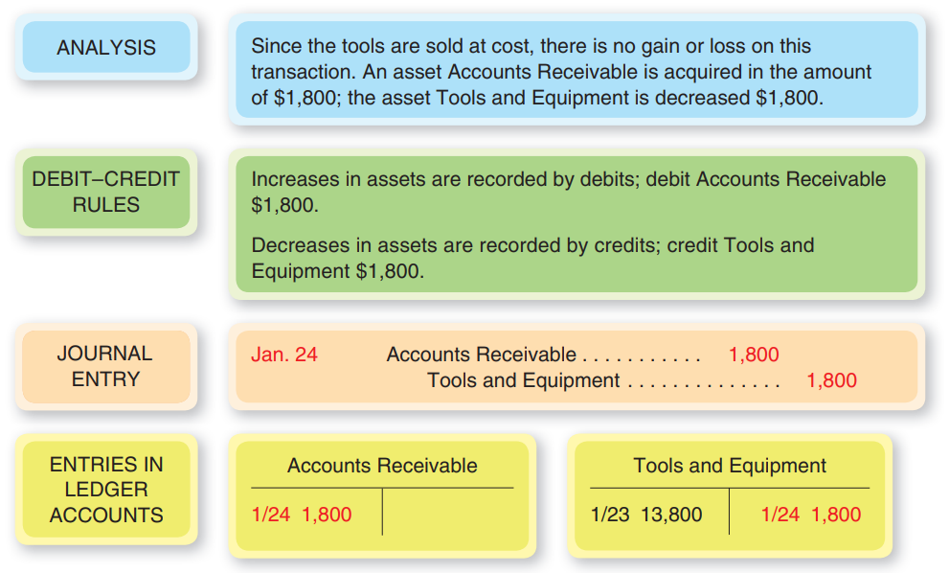

Slide 18
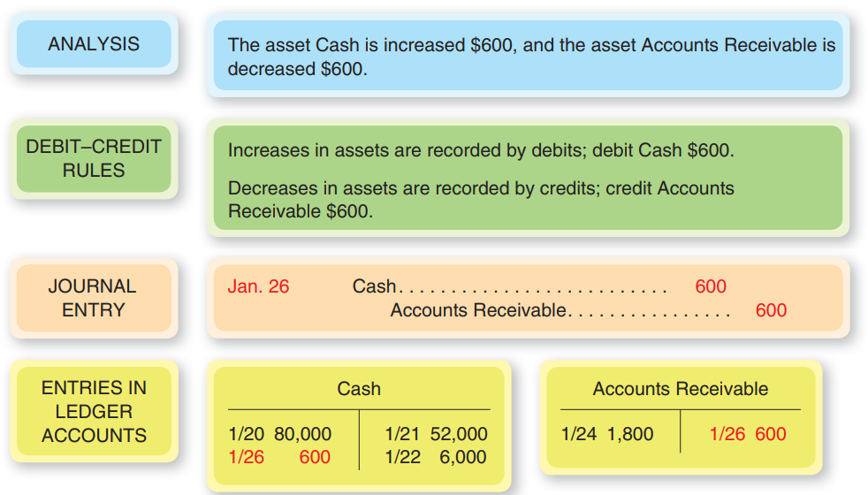

Slide 19
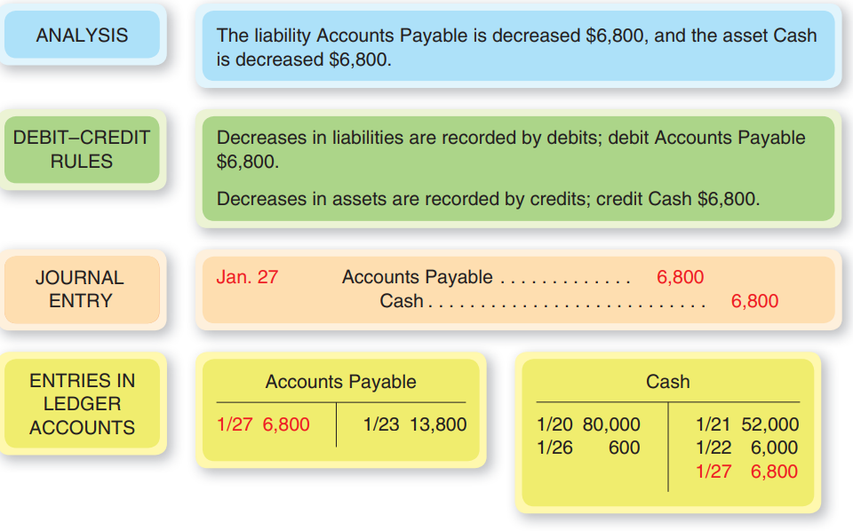

Slide 20
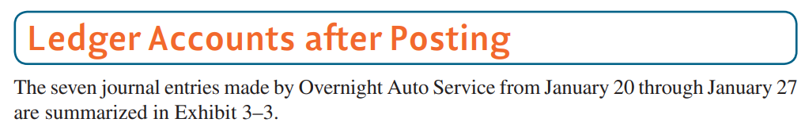
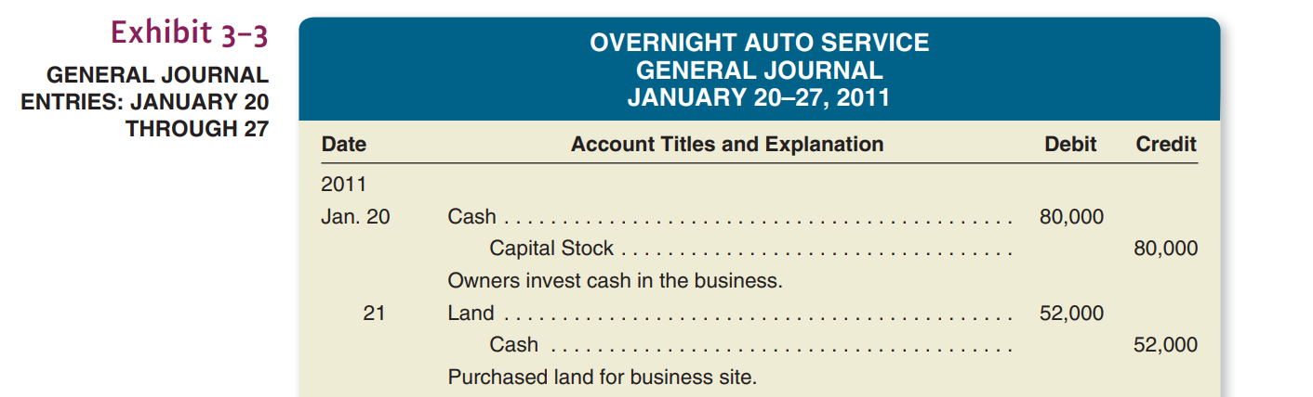

Slide 21
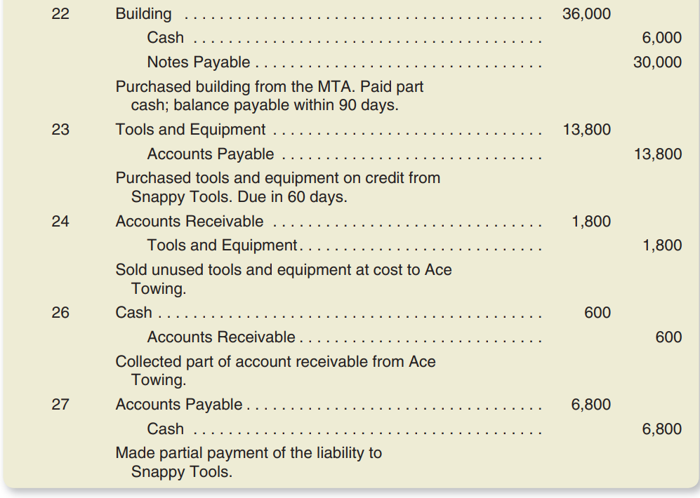

Slide 22
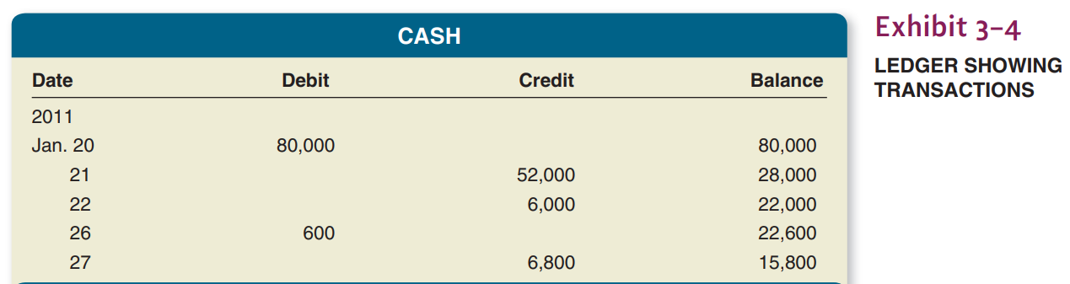
After all of the journal entries in Exhibit 3–3 have been posted, Overnight’s ledger accounts appear as shown in Exhibit 3–4 . The accounts are arranged in the same order as in the balance sheet—that is, assets first, followed by liabilities and owners’ equity accounts. Each ledger account is presented in what is referred to as a running balance format (as opposed to simple T accounts).

Slide 23
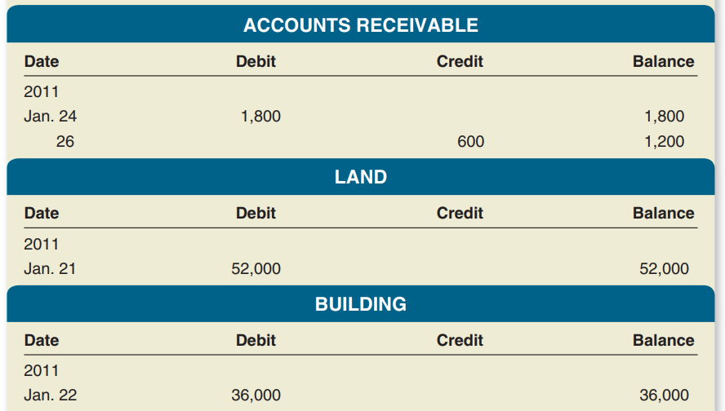

Slide 24
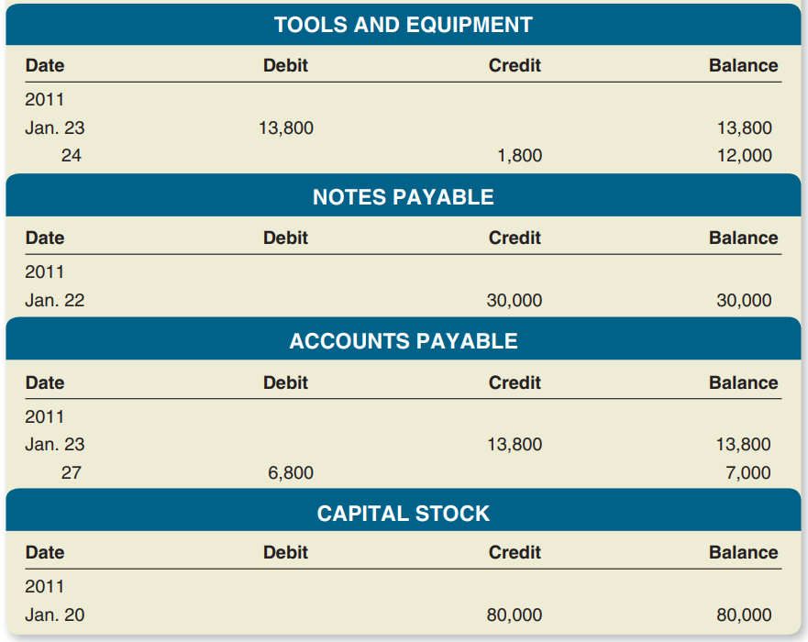

Slide 25

In Chapter 2, we introduced Overnight Auto Service, a small auto repair shop formed on January 20, 2011. Early in this chapter, we journalized and posted all of Overnight’s balance sheet transactions through January 27.
At this point we will illustrate the manner in which Overnight’s January income statement transactions were handled and continue into February with additional transactions. Three transactions involving revenue and expenses were recorded by Overnight on January 31, 2011.

Slide 26
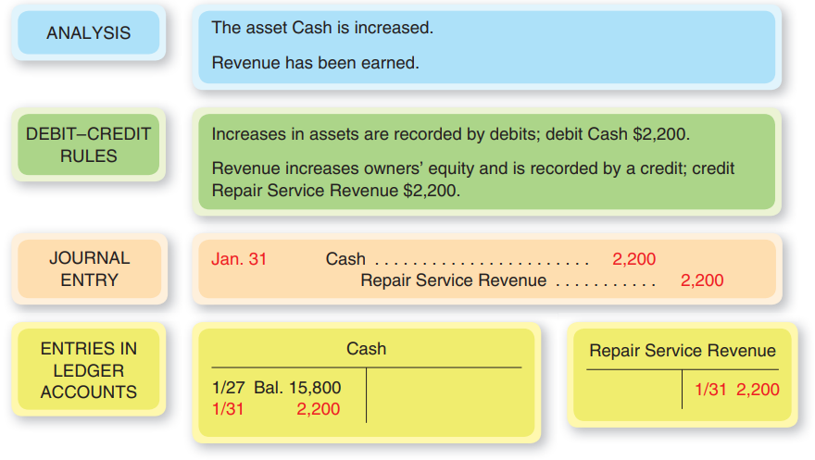
The following illustrations provide an analysis of each transaction.
Jan. 31 Recorded revenue of $2,200, all of which was received in cash.

Slide 27
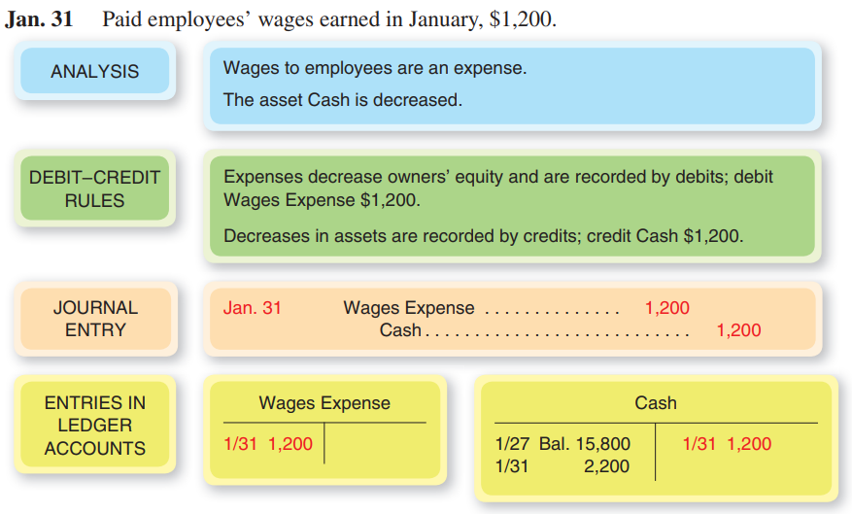

Slide 28
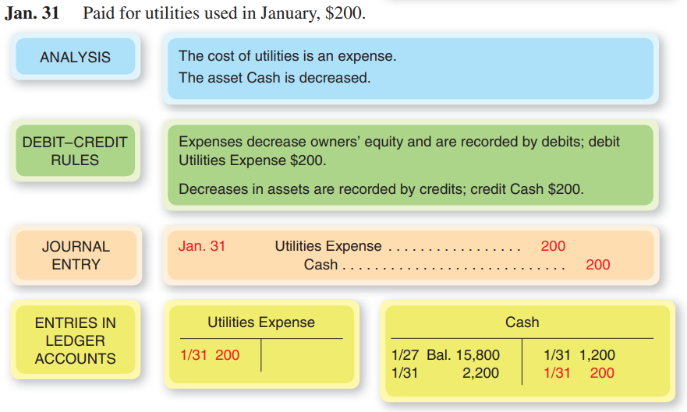

Slide 29
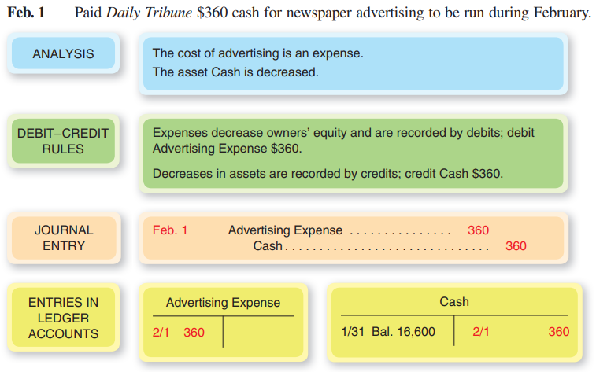

Slide 30
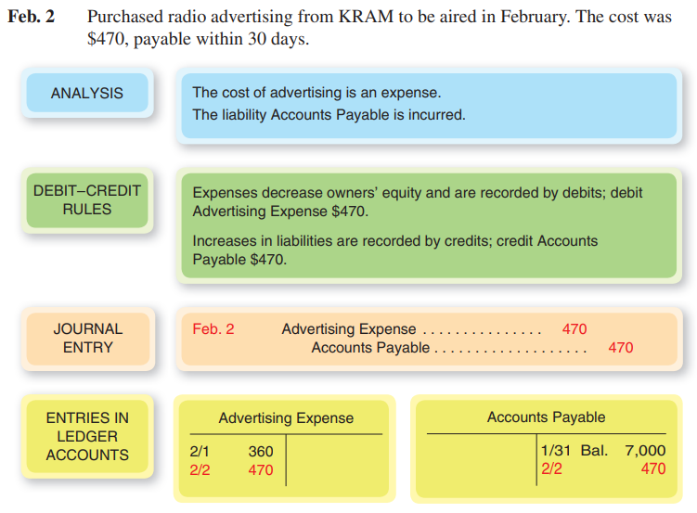

Slide 31
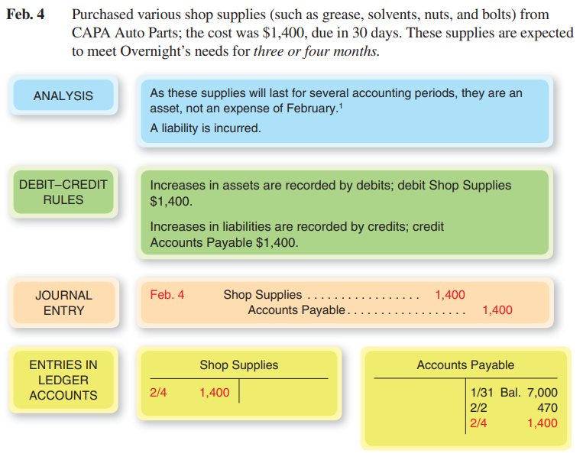

Slide 32
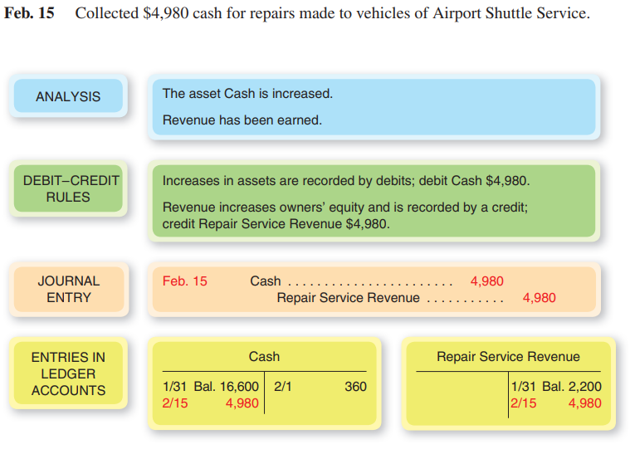

Slide 33
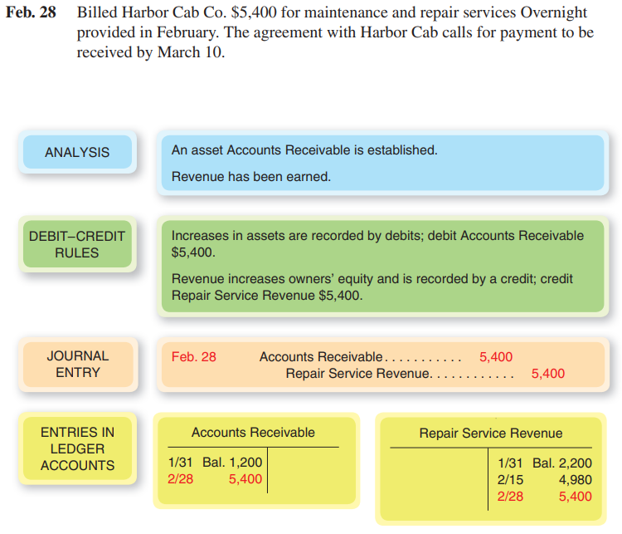

Slide 34
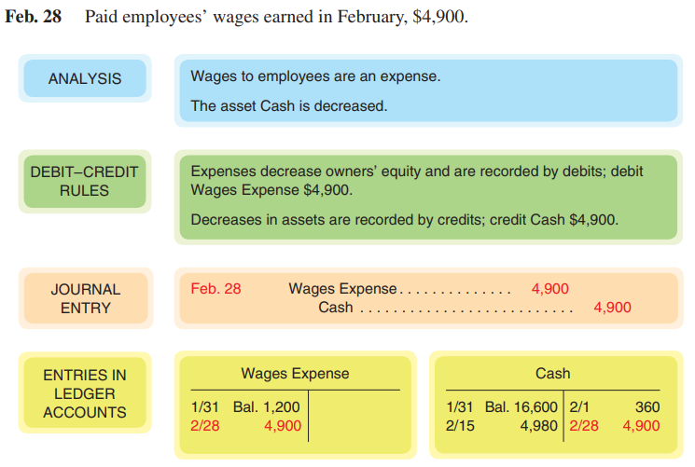

Slide 35
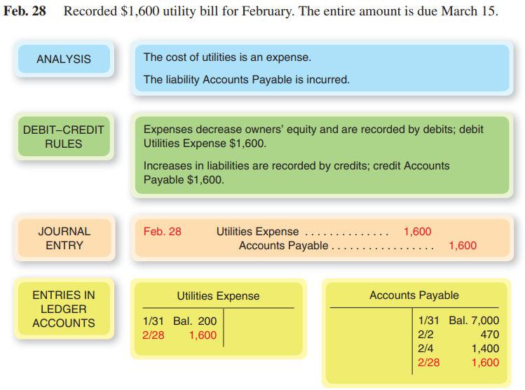

Slide 36
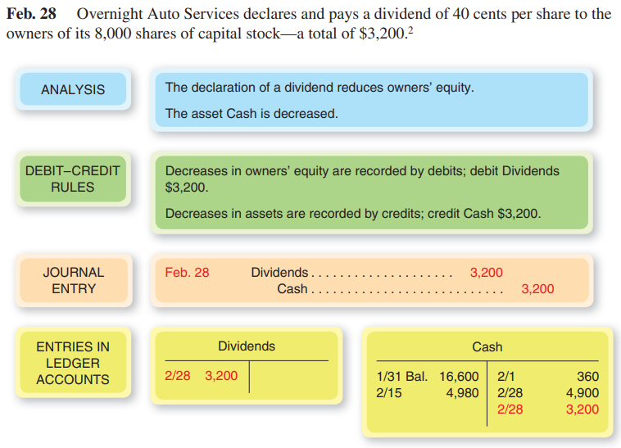

Slide 37
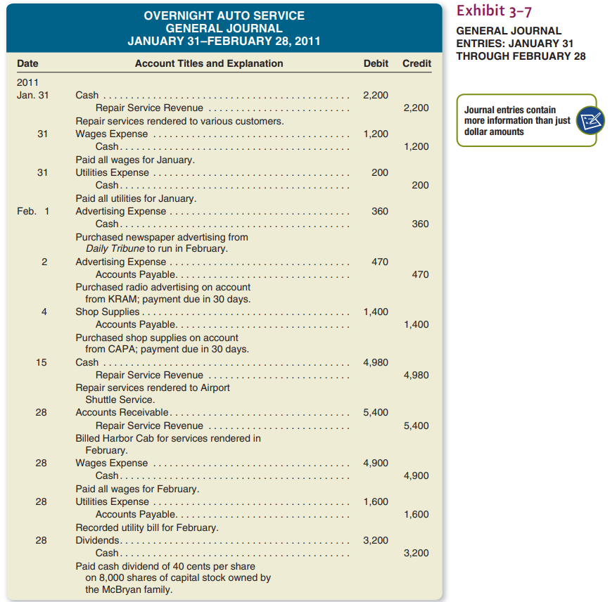

Slide 38

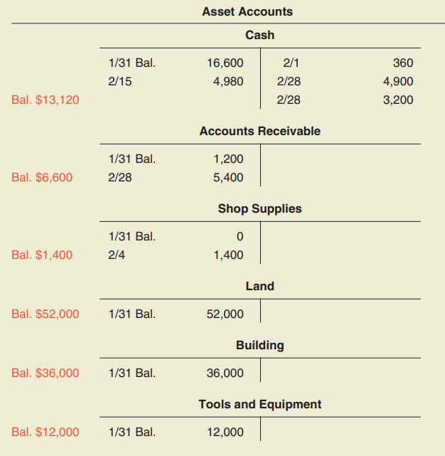

Slide 39
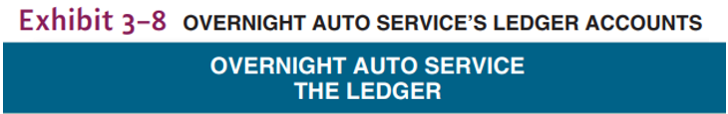
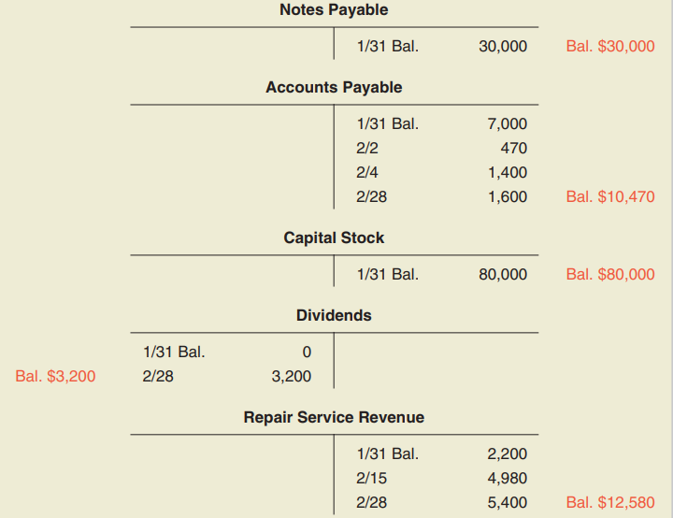

Slide 40
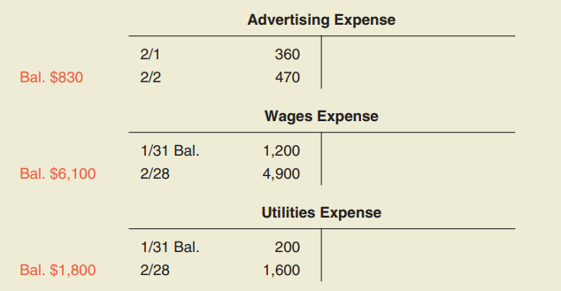

Slide 41
Before using the account balances to prepare a balance sheet, it is desirable to prove that the total of accounts with debit balances is in fact equal to the total of accounts with credit balances. This proof of the equality of debit and credit balances is called a trial balance.
A trial balance is a two-column schedule listing the names and balances of all the accounts in the order in which they appear in the ledger ; the debit balances are listed in the left-hand column and the credit balances in the right-hand column.
The totals of the two columns should agree. A trial balance taken from Overnight Auto’s ledger accounts is shown in Exhibit 3–9 .

Slide 42
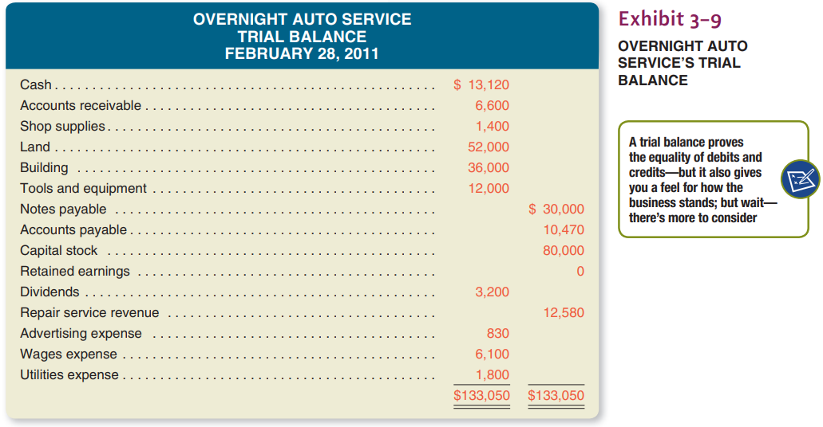

Slide 43
The trial balance provides proof that the ledger is in balance. The agreement of the debit and credit totals of the trial balance gives assurance that:
Equal debits and credits have been recorded for all transactions.
The addition of the account balances in the trial balance has been performed correctly.
Suppose that the debit and credit totals of the trial balance do not agree. This situation indicates that one or more errors have been made. Typical of such errors are (1) the posting of a debit as a credit, or vice versa; (2) arithmetic mistakes in determining account balances; (3) clerical errors in copying account balances into the trial balance; (4) listing a debit balance in the credit column of the trial balance, or vice versa; and (5) errors in addition of the trial balance.

